Slide 1
Salary Data Analysis

Slide 2
Dataset Overview
Number of entries: 1000 (example)
Columns:
• Age
• Gender
• Education Level
• Job Title
• Years of Experience
• Salary
Dataset is clean and usable for analysis.

Slide 3
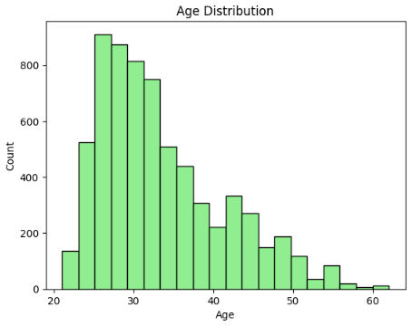
Age Distribution (Histogram)
Explanation: Shows how ages are distributed in the dataset.
Insights: Majority of employees fall between 25–40 years old.

Slide 4
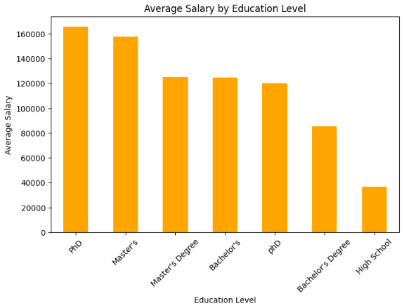
Average Salary by Education Level (Bar Chart)
Explanation: Compares mean salary across different education levels.
Insights: Employees with higher education levels earn more on average.

Slide 5
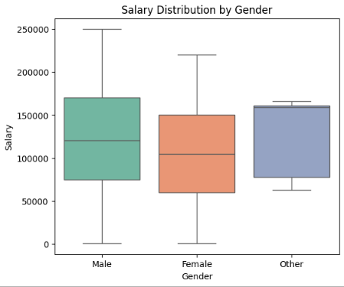
Salary Distribution by Gender (Boxplot)
Explanation: Displays salary spread for male and female employees.
Insights: Gender-based pay differences can be observed.

Slide 6
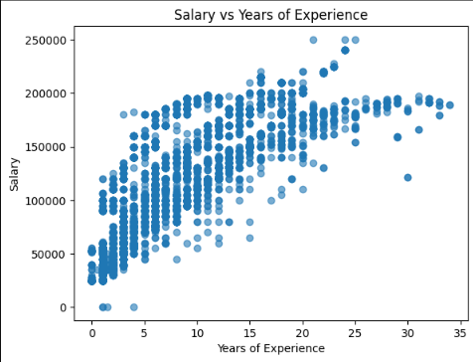
Salary vs Years of Experience (Scatter Plot)
Explanation: Shows relation between work experience and salary.
Insights: Strong positive correlation – higher experience generally leads to higher salaries.

Slide 7
Code Walkthrough: Transformations
• groupBy() applied on Gender, Education Level, Job Title.
• avg() used to compute mean salary.
• Correlation checked between Age, Experience, and Salary.
• orderBy() used for sorting results.

Slide 8
Code Walkthrough: Data Loading
• Used PySpark to read Salary_Data.csv into a DataFrame.
• Schema inferred automatically from header.
• Verified schema with printSchema().
• Previewed data with show().

Slide 9
Code Walkthrough: Visualizations
• Converted Spark DataFrames to Pandas with toPandas().
• Used matplotlib and seaborn for plots.
• Generated:
Histogram of Age
Bar Chart of Avg Salary by Education
Boxplot of Salary by Gender
Scatter Plot of Salary vs Experience

Slide 10
Conclusion
• Education level and years of experience are strong predictors of salary.
• Gender-based salary gaps are visible.
• Higher education and more experience generally lead to better pay.
• Dataset is valuable for compensation planning and workforce insights.

